Slide 1

SE-3002 Software quality engineering Rubab Jaffar rubab.jaffar@nu.edu.pk
Part II-Software Testing
Structural Testing
Lecture # 25, 26, 27

Slide 2
Today’s Outline
Structural Testing
Data Flow Testing
Slice based testing
Mutation testing

Slide 3
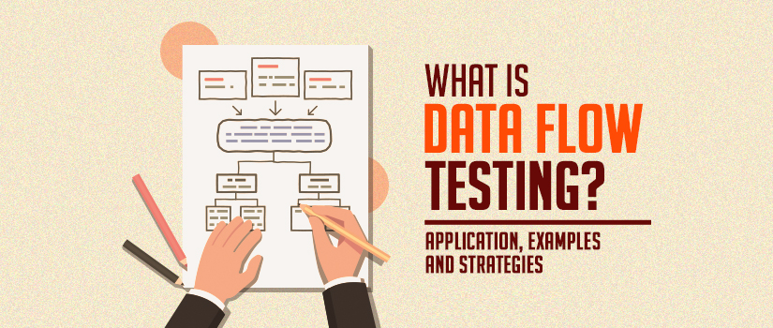

Slide 4
Data flow testing
Int a;
If(a==47)
In path coverage, the stress was to cover a path using statement or branch coverage.
However, data and data integrity is as important as code and code integrity of a module.
We have checked every possibility of the control flow of a module. But what about the data flow in the module?
Has every data object been initialized prior to use?
Have all defined data objects been used for something?

Slide 5
Data flow testing
Statements where these values are used (referenced).
Statements where variables receive values (definition).
Data flow testing focuses on variable definition and variable usage.
The process is conducted to detect the bugs because of the incorrect usage of data variables or data values.

Slide 6
Define/Reference Anomalies
Some of the define / reference anomalies are given as:
A variable is defined but never used / referenced.
A variable is used but never defined.
A variable is defined twice before it is used.
A variable is used before even first-definition.
Define / reference anomalies may be identified by static analysis of the program.

Slide 7
Data flow testing terms definitions
A program is first converted into a program graph.
Defining node
A node of a program graph is a defining node for a variable , if and only if, the value of the variable is defined in the statement corresponding to that node. It is represented as DEF ( , n) where is the variable and n is the node corresponding to the statement in which is defined.
Usage node
A node of a program graph is a usage node for a variable , if and only if, the value of the variable is used in the statement corresponding to that node. It is represented as USE ( , n), where ‘ ’ is the variable and ‘n’ in the node corresponding to the statement in which ‘ ’ is used.
A usage node USE ( , n) is a predicate use node (denoted as P-use), if and only if, the statement corresponding to node ‘n’ is a predicate statement otherwise USE ( , n) is a computation use node (denoted as C-use).

Slide 8
There are also three other types of usage node, which are all, in effect,
subclasses of the C-use type:
O-use: output use – the value of the variable is output to the external
environment (for instance, the screen or a printer).
L-use: location use – the value of the variable is used, for instance, to
determine which position of an array is used (e.g. a[b]).
I-use: iteration use – the value of the variable is used to control the
number of iterations made by a loop (for example: for (int i = 0;i <= 10; i++)).

Slide 9
Data flow testing terms definitions
Definition use Path
A definition use path (denoted as du-path) for a variable ‘ ’ is a path between two nodes ‘m’ and ‘n’ where ‘m’ is the initial node in the path but the defining node for variable ‘ ’ (denoted as DEF ( , m)) and ‘n’ is the final node in the path but usage node for variable ‘ ’ (denoted as USE ( , n)).

Slide 10

Identification of du Paths
The various steps for the identification of du and dc paths are given as:
Draw the program graph of the program.
Find all variables of the program and prepare a table for define / use status of all variables using the following format:
Generate all du-paths from define/use variable table of above step using the following

Slide 11
Testing Strategies Using du-Paths
We want to generate test cases which trace every definition to each of its use and every use is traced to each of its definition. Some of the testing strategies are given as:
Test all du-paths
All du-paths generated for all variables are tested. This is the strongest data flow testing strategy covering all possible du-paths.
Test all uses
Find at least one path from every definition of every variable to every use of that variable which can be reached by that definition.
For every use of a variable, there is a path from the definition of that variable to the use of that variable.

Slide 12
Testing Strategies Using du-Paths
Test all definitions
Find paths from every definition of every variable to at least one use of that variable;
The first requires that each definition reaches all possible uses through all possible du-paths, the second requires that each definition reaches all possible uses, and the third requires that each definition reaches at least one use.

Slide 13
Types of Data Flow Testing
Static Data Flow Testing
No actual execution of the code is carried out in Static Data Flow testing. Generally, the definition, and usage pattern of the data variables is scrutinized through a control flow graph.
Dynamic Data Flow Testing
The code is executed to observe the transitional results. Dynamic data flow testing includes:
Identification of definition and usage of data variables.
Identifying viable paths between definition and usage pairs of data variables.
Designing & crafting test cases for these paths.

Slide 14
Data Flow Testing Limitations
Testers require good knowledge of programming.
Time-consuming
Costly process.

Slide 15
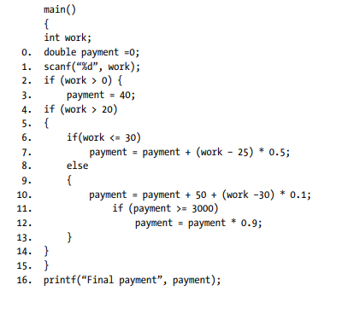

Slide 16
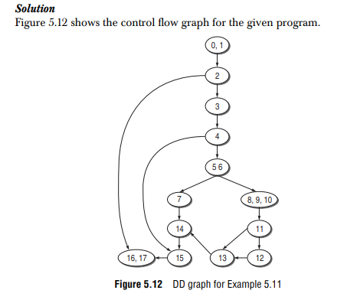
Step 1

Slide 17
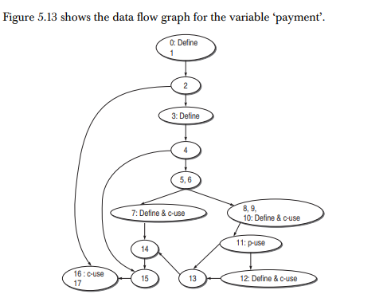
Step II

Slide 18
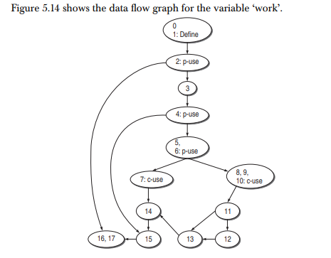
Step II (continue)

Slide 19
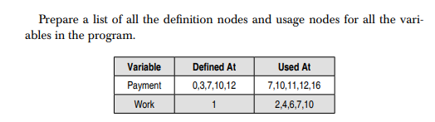
Step iii

Slide 20
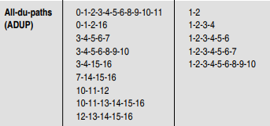
Test cases

Slide 21
Practice Question (Derive all du-paths)
. Consider the program to find the greatest number:
#include <stdio.h>
main()
{
fl oat x,y,z;
clrscr();
printf(“enter the three variables x,y,z”);
scanf(“%f %f %f”,&x,&y,&z);
if(x > y)
{
if(x > z)
printf(“x is greatest”);
else
printf(“z is greatest”);
}
else
{
if(y > z)
printf(“y is greatest”);
else
printf(“z is greatest”);
}
getch();
}

Slide 22
SLICE BASED TESTING
We prepare various subsets (called slices) of a program with respect to its variables and their selected locations in the program.
Each variable with one of its location will give us a program slice.
A large program may have many smaller programs (its slices), each constructed for different variable subsets.
Only two things are important here, variable and its selected location in the program.
Program slicing is a technique for restricting the behavior of a program to some specified subset of interest.

Slide 23
Guidelines for Slicing
All statements where variables are defined and redefined should be considered.
All statements where variables receive values externally should be considered.
All statements where output of a variable is printed should be considered.
The status of all variables may be considered at the last statement of the program.

Slide 24
#include<stdio.h>
#include<conio.h>
#include<math.h>
1. void main() //Main Begins
2. {double a,b,c;
4. double a1,a2,a3;
5. int valid=0;
6. clrscr();
7. printf("Enter first side of the triangle:");
8. scanf("%lf",&a);
9. printf("Enter second side of the triangle:");
10. scanf("%lf",&b);
11. printf("Enter third side of the triangle:");
12. scanf("%lf",&c);
13.if(a>0&&a<=100&&b>0&&b<=100&&c>0&&c<=100) {
14. if((a+b)>c&&(b+c)>a&&(c+a)>b) {
15. valid=1;
16. }
17. else {
18. valid=-1;
19. }
20. }
21. if(valid==1) {
22. a1=(a*a+b*b)/(c*c);
23. a2=(b*b+c*c)/(a*a);
24. a3=(c*c+a*a)/(b*b);
25. if(a1<1||a2<1||a3<1) {
26. printf("Obtuse angled triangle");
27. }
28. else if(a1==1||a2==1||a3==1) {
29. printf("Right angled triangle");
30. }
31. else {
32. printf("Acute angled triangle");
33. }
34. }
35. else if(valid==-1) {
36. printf("\nInvalid Triangle");
37. }
38. else {
39.
printf("\nInput Values are Out of Range");
40. }
41. getch();
42. } //Main Ends
S(valid,5)

Slide 25
Creation of Program Slices
Consider the portion of a program given in Figure 4.2 for the identification of its slices.
a = 3;
b = 6;
c = b²;
d = a²+ b²;
c = a + b;

Slide 26
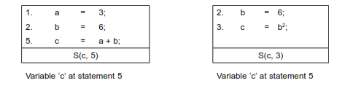
Program slices
We identify two slices for variable ‘c’ at statement number 3 and statement number 5.

Slide 27
Example Code: We also consider the program to find the largest number amongst three numbers as given . There are three variables A, B and C in the program. We may create many slices like S (A, 28), S (B, 28), S (C, 28)
#include<stdio.h>
#include<conio.h>
1. void main()
2. {
3. float A,B,C;
4. clrscr();
5. printf("Enter number 1:\n");
6. scanf("%f", &A);
7. printf("Enter number 2:\n");
8. scanf("%f", &B);
9. printf("Enter number 3:\n");
10. scanf("%f", &C);
/*Check for greatest of three numbers*/
11. if(A>B) {
12. if(A>C) {
13. printf("The largest number is: %f\n",A);
14. }
15. else {
16. printf("The largest number is: %f\n",C);
17. }
18. }
19. else {
20. if(C>B) {
21. printf("The largest number is: %f\n",C);
22. }
23. else {
24. printf("The largest number is: %f\n",B);
25. }
26. }
27. getch();
28. }

Slide 28
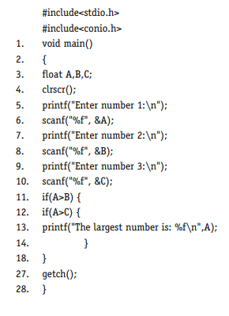
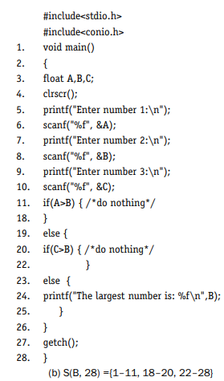
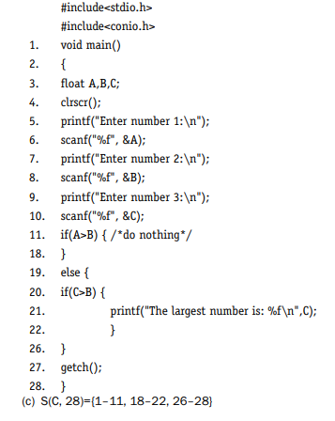


Slide 29
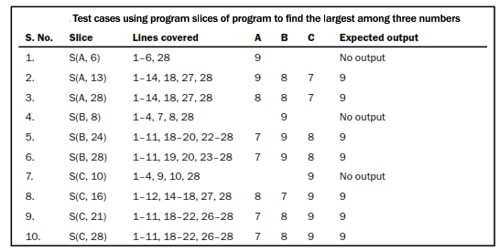
Test cases

Slide 30
Limitations of slice based testing
Slice based testing is a popular structural testing technique and focuses on a portion of the program with respect to a variable location in any statement of the program.
Hence slicing simplifies the way of testing a program’s behavior with respect to a particular subset of its variables.
But slicing cannot test a behavior which is not represented by a set of variables or a variable of the program.

Slide 31
Mutation testing
Popular technique to assess the effectiveness of a test suite.
A large number of test cases for any program can be generated but cant execute all of them due to time or resources.
So the idea is to select a few test cases using any testing technique and prepare a test suite.

Slide 32
Mutation testing
If the test suite is not able to make the program fail, there may be one of the following reasons:
The test suite is effective but hardly any errors are there in the program.
The test suite is not effective and could not find any errors. Although there may be errors, they could not be detected due to poor selection of test suite.

Slide 33
Mutation and Mutants
Mutation is the process of changing a program.
This change may be limited to one, two or very few changes in the program.
Notes:
We prepare a copy of the program under test and make a change in a statement of the program. This changed version of the program is known as a mutant of the original program.
The behaviour of the mutant may be different from the original program due to the introduction of a change.

Slide 34
Mutation and Mutants
To mutate a program means to change a program. We generally make only one or two changes in order to assess the effectiveness of the selected test suite
We may make many mutants of a program by making small changes in the program.
Every mutant will have a different change in a program.
Every change of a program may give a different output as compared to the original program.
The original program and mutant are syntactically correct and should compile correctly.

Slide 35
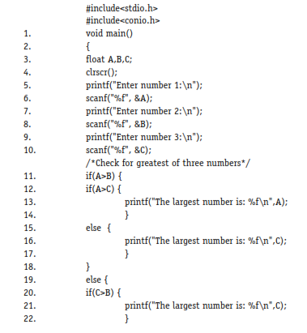
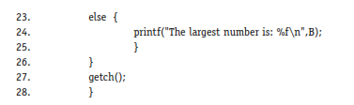
Example: find the largest number amongst three numbers.

Slide 36


First order mutant of the example program
Many changes can be made in the program.
Mutant M₁ is obtained by replacing the operator ‘>’ of line number 11 by the operator ‘ =’.
Mutant M₂ is obtained by changing the operator ‘>’ of line number 20 to operator ‘<’.
These changes are simple changes. Only one change has been made in the original program to obtain mutant M₁ and mutant M₂.
M_{1:} First order mutant
M_{2:} First order mutant

Slide 37
High order mutant
The mutants generated by making only one change are known as first order mutants.
We may obtain second order mutants by making two simple changes in the program and third order mutants by making three simple changes, and so on.
The second order mutant (M₃) of the example program can be obtained by making two changes in the program and thus changing operator ‘>’ of line number 11 to operator ‘<’ and operator ‘>’ of line number 20 to ‘ >=’ .
The second order mutants and above are called higher order mutants.
Generally, in practice, we prefer to use only first order mutants in order to simplify the process of mutation.

Slide 38
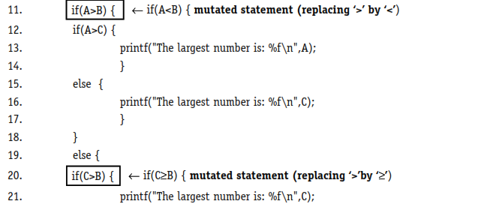
Second order mutant

Slide 39
Mutation Operators
Mutants are produced by applying mutant operators.
We should measure the degree to which the program is changed. If the original expression is x + 1, and the mutant for that expression is x + 2, that is considered as a lesser change as compared to a mutant where the changed expression is (y * 2) by changing both operands and the operator.
If x – y is changed to x – 5 to make a mutant, then we should not use the value of y to be equal to 5. If we do so, the fault will not be revealed.

Slide 40
Mutation Operators
Some of the mutant operators for object oriented languages like Java, C++ are given as:
Static modifier change
Changing the access modifier, like public to private.
Argument order change
Operator change
Any operand change by a numeric value.

Slide 41

Mutation Score
When we execute a mutant using a test suite, we may have any of the following outcomes:
The results of the program are affected by the change and any test case of the test suite detects it. If this happens, then the mutant is called a killed mutant.
The results of the program are not affected by the change and any test case of the test suite does not detect the mutation. The mutant is called a live mutant.
The mutation score associated with a test suite and its mutants is calculated as:

Slide 42
mutation score
The mutation score measures how sensitive the program is to the changes and how accurate the test suite is.
A mutation score is always between 0 and 1.
A higher value of mutation score indicates the effectiveness of the test suite .
The live mutants are important for us and should be analyzed thoroughly.

Slide 43
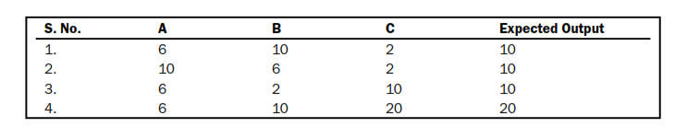
Example: program to find the largest of three numbers
Generate five mutants (M₁ to M₅ ) and calculate the mutation score of this test suite.

Slide 44
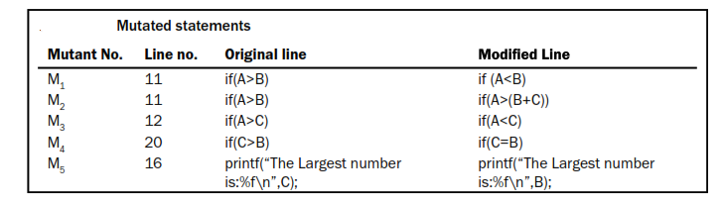
Five mutants

Slide 45
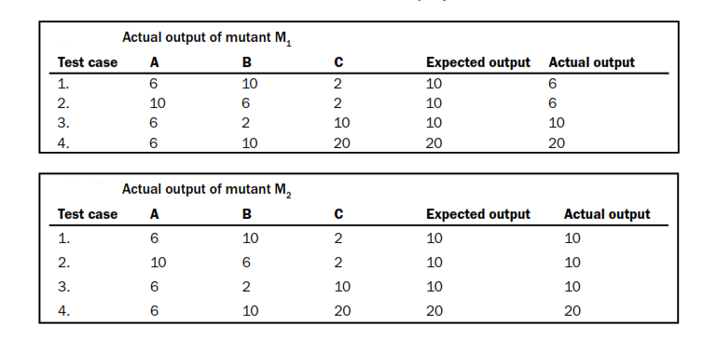
Program results after executing mutants

Slide 46
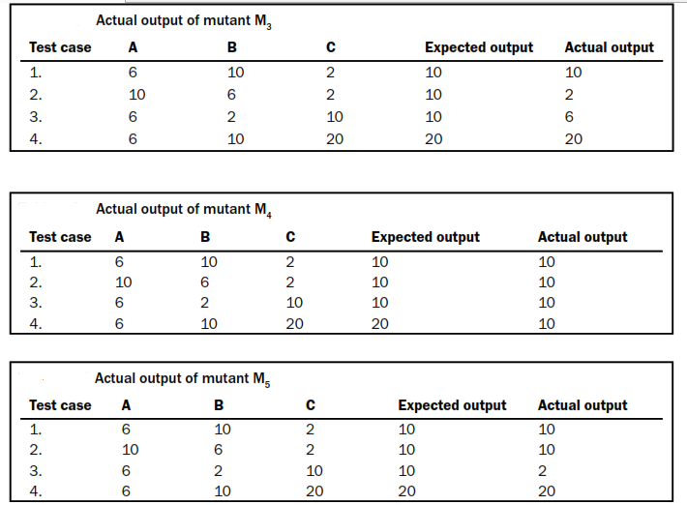
Program results after executing mutants

Slide 47
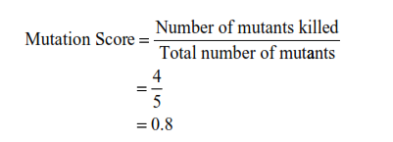
Mutation score

Slide 48
That is all

